Slide 1
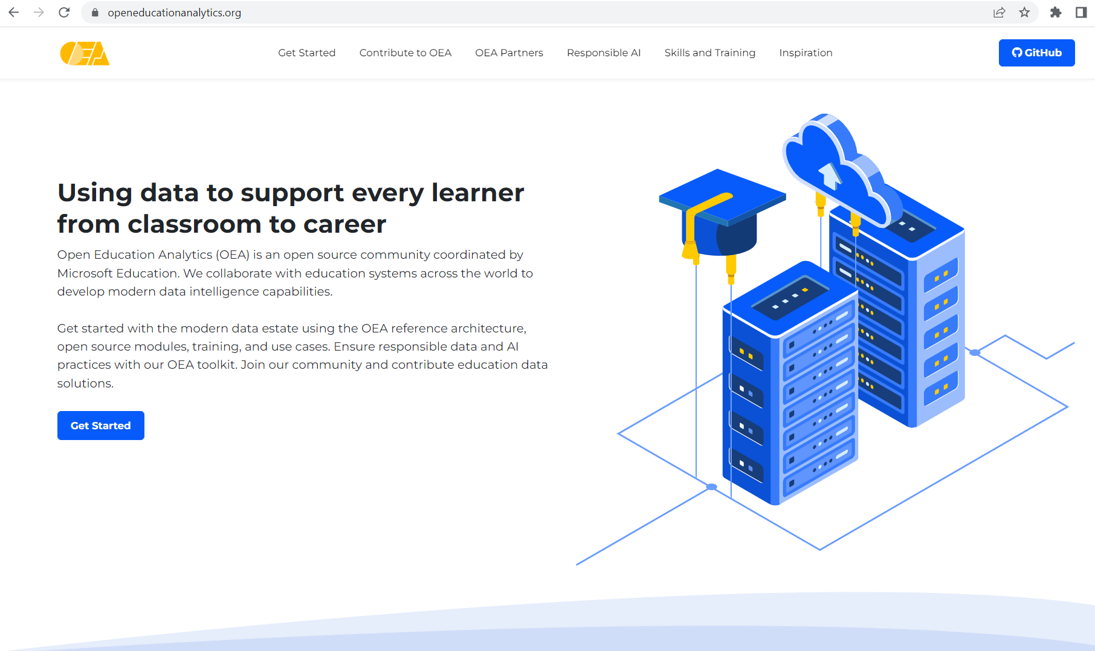

Slide 2
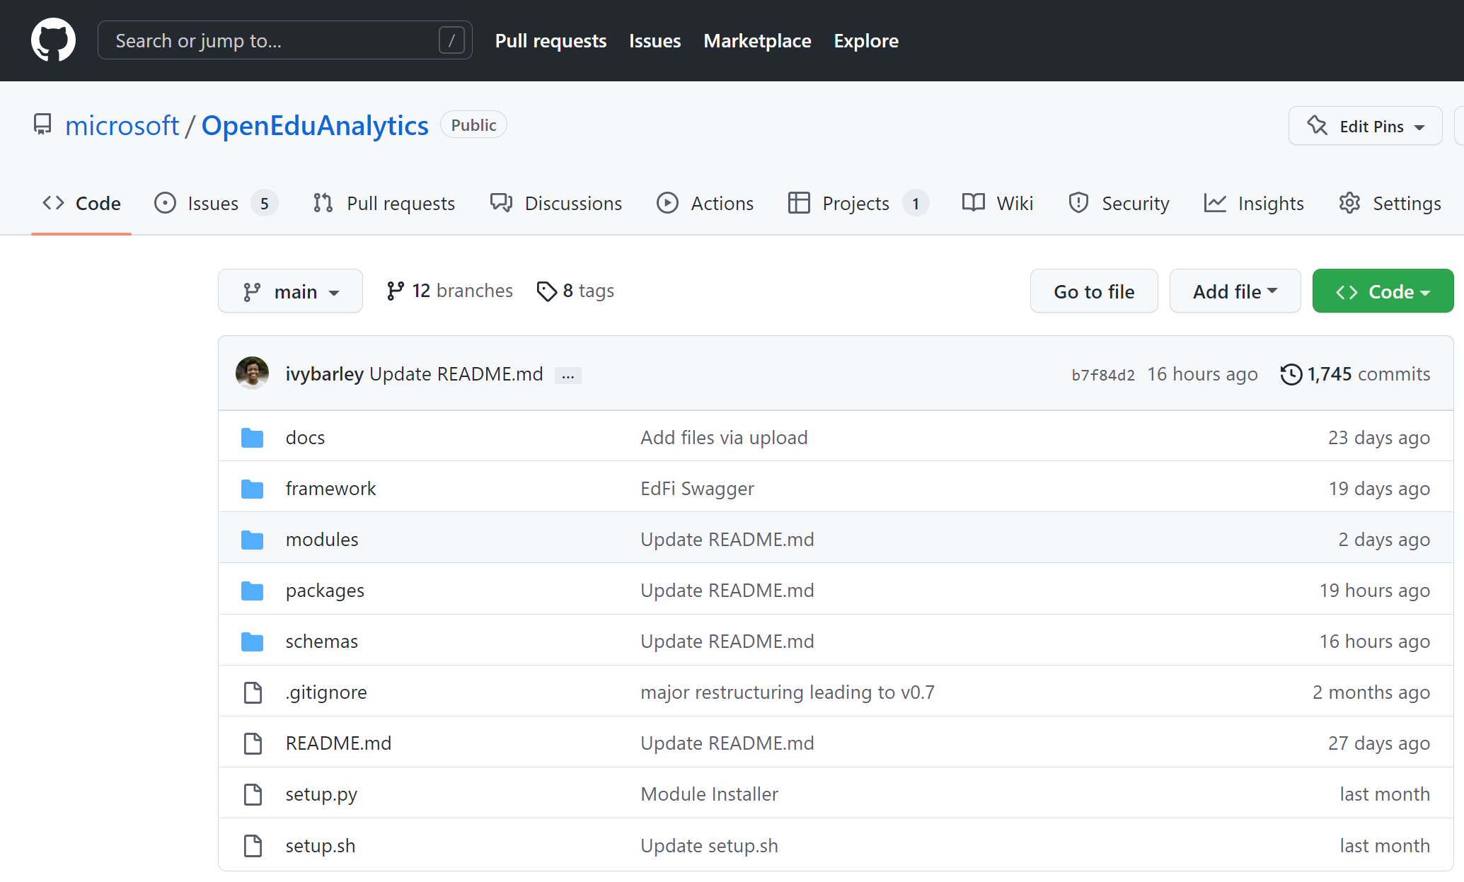
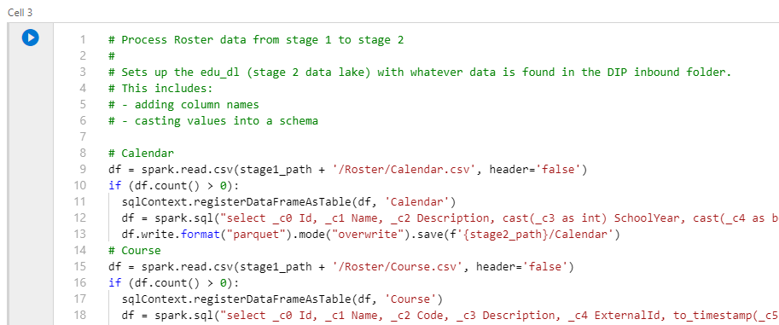
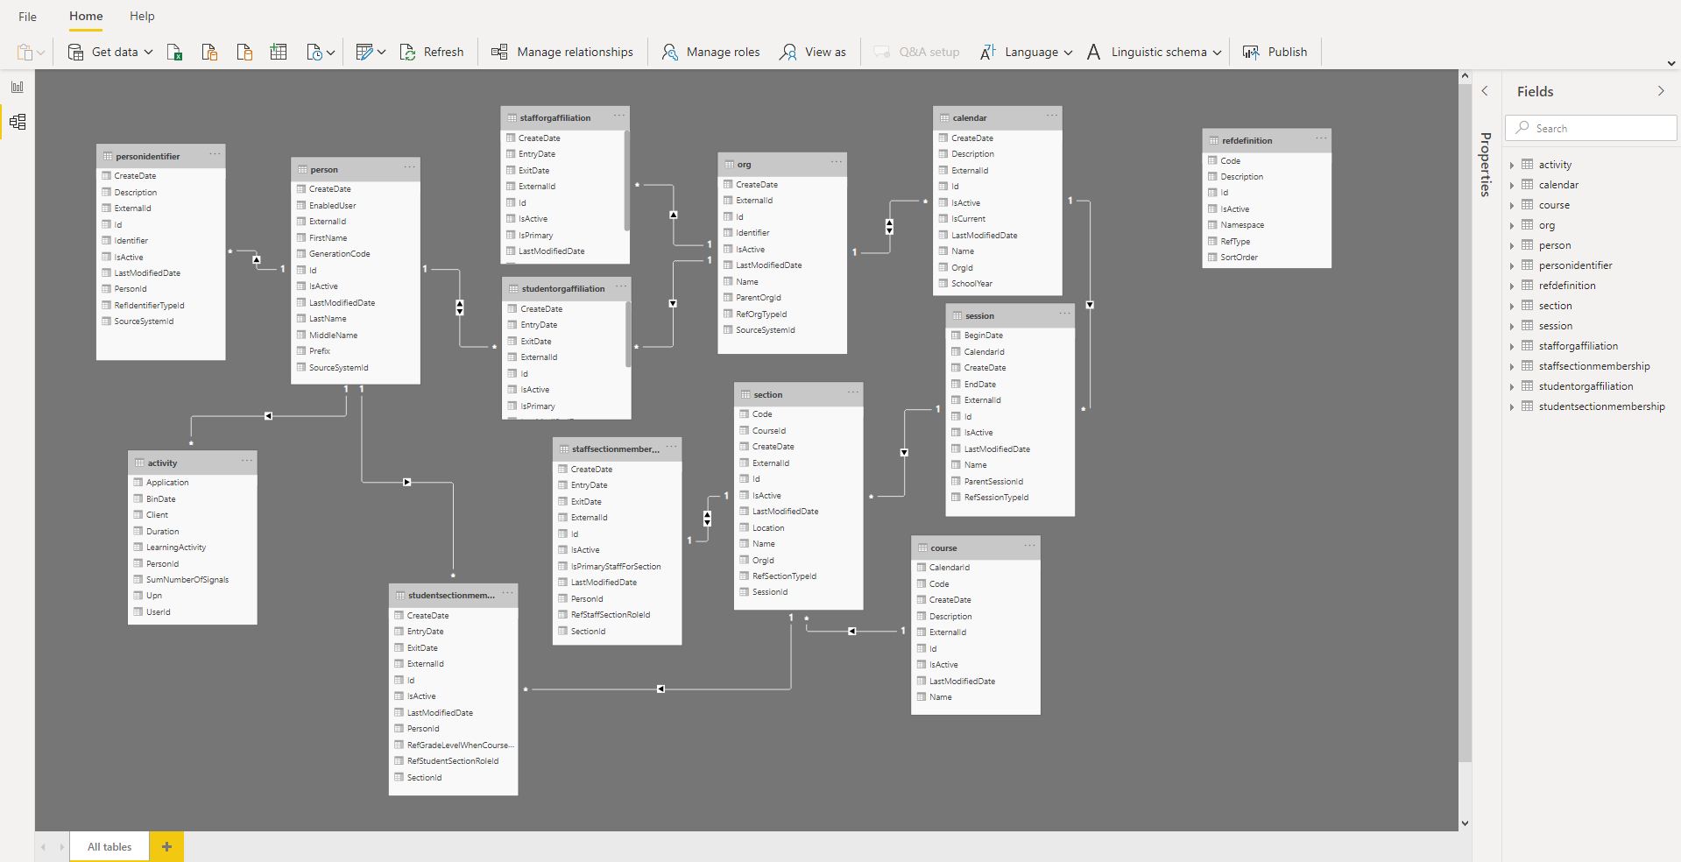
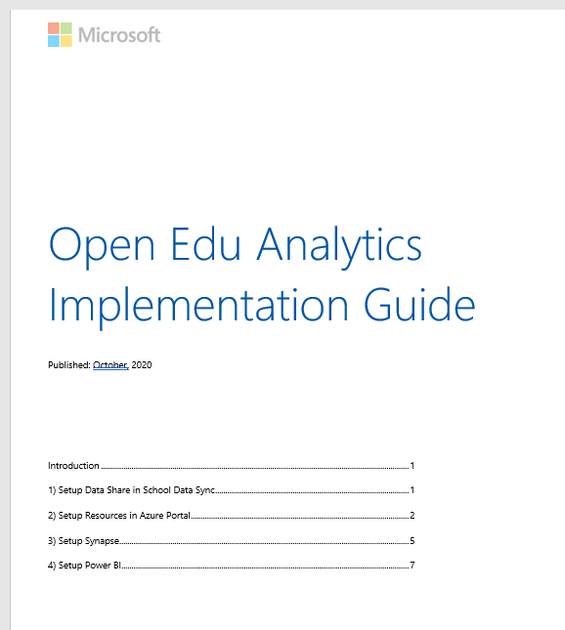
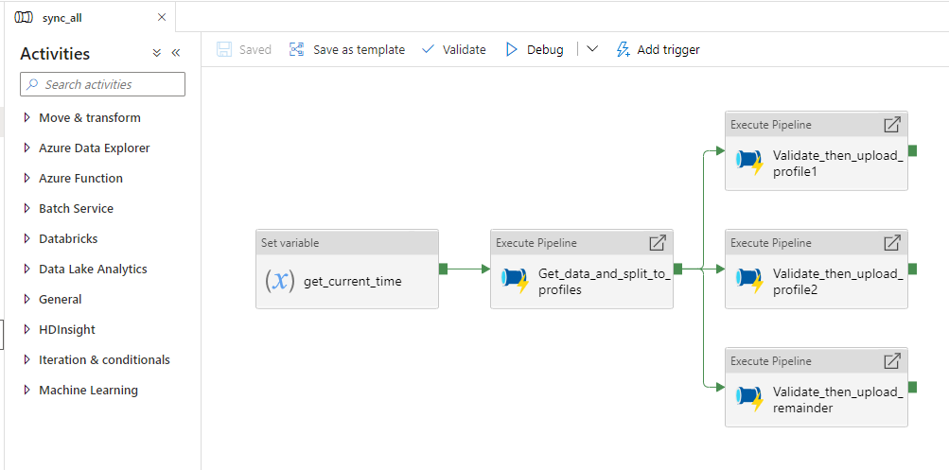
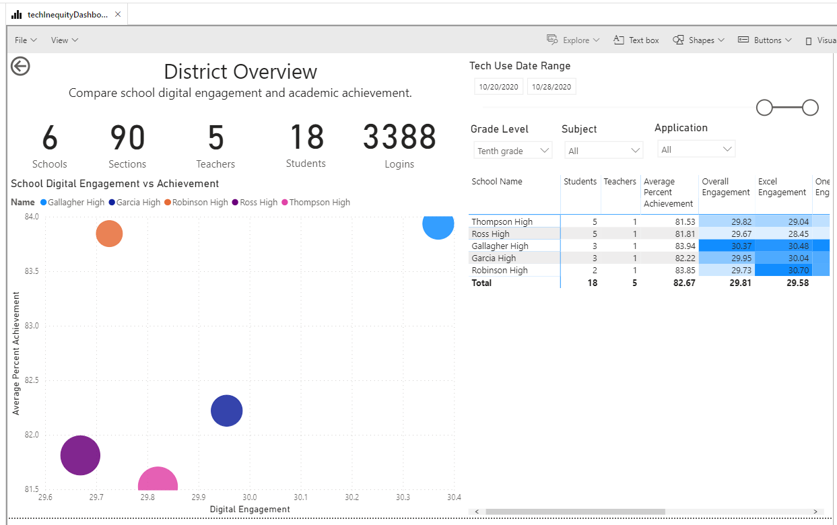

Slide 3
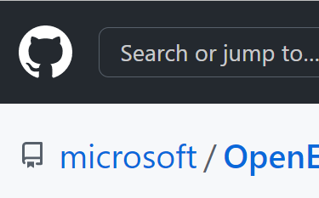


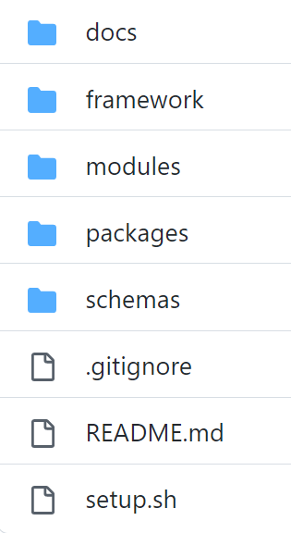


OEA repo update
OEA Package: Hybrid Engagement
Synapse
Power BI
OEA Package: Digital Equity of Access
OEA Package: Chronic Absenteeism
module
module
schema
package scripts
package reports
framework
Data Lakehouse

Slide 4

The Ecosystem
The Tech
Custom Assets
customers
partners
feedback
Modules
Packages
refine
standardize
commoditize
technical
guidance
Framework, Conventions, Standards
Platform
prod mgrs
developers
Notes:
Growing the assets with the ecosystem to serve customers today
while improving standards and the platform for tomorrow…

Slide 5
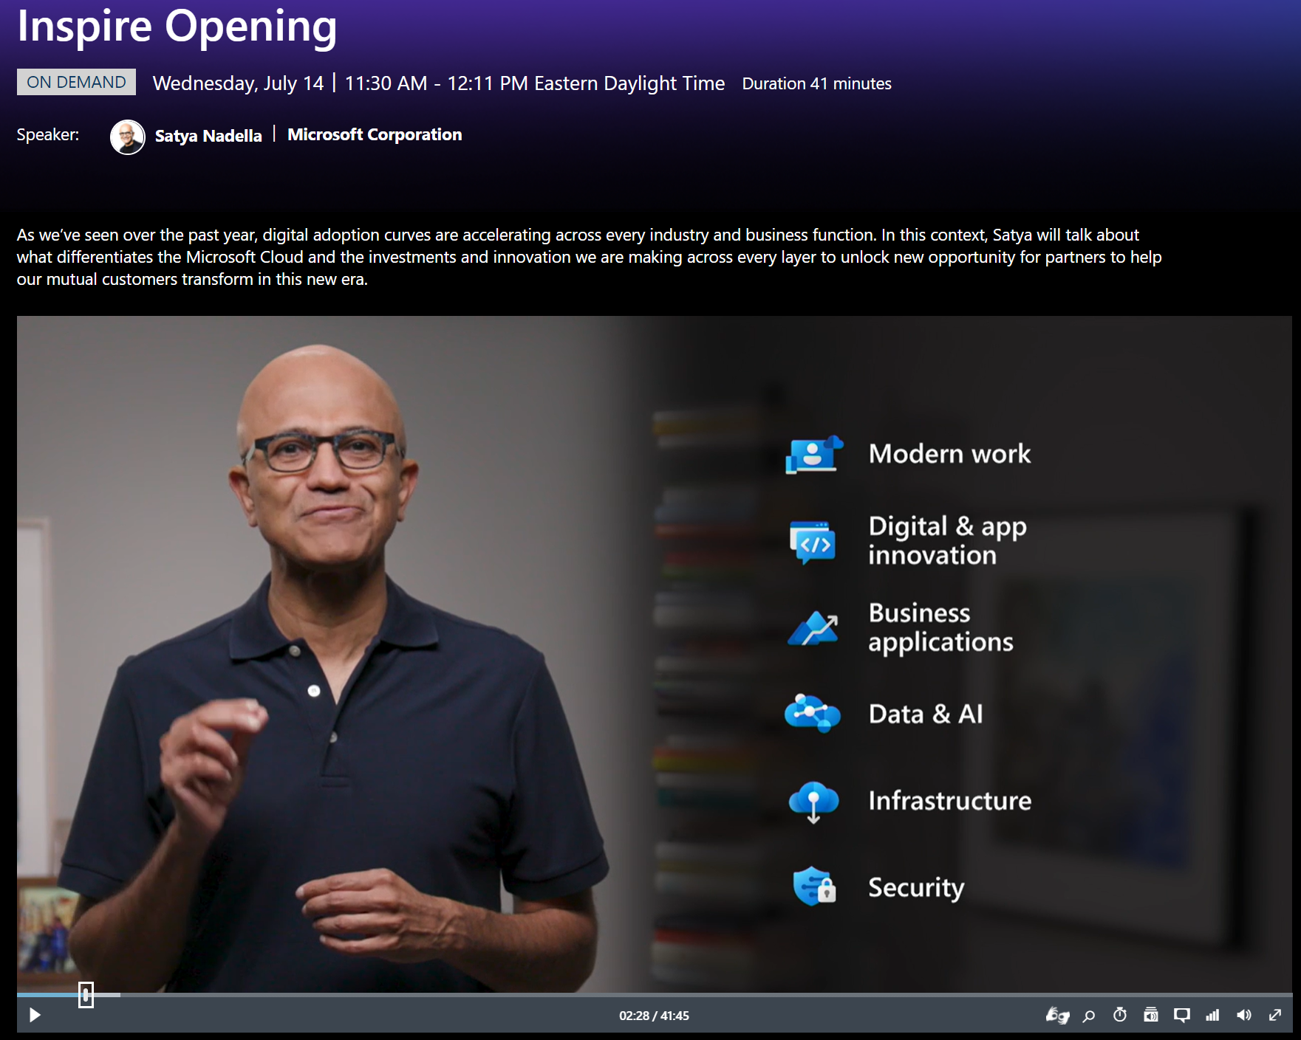

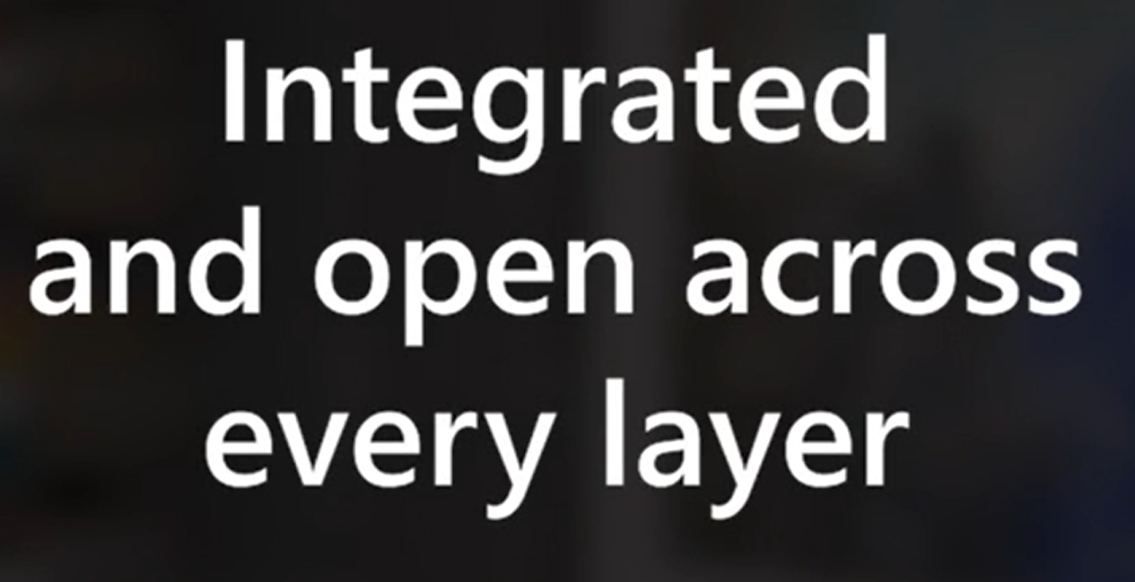
“Our ambition is to foster foundational innovation that creates entire ecosystems even greater than the platforms themselves.
That’s what the Microsoft cloud uniquely enables.”
Notes:
https://myinspire.microsoft.com/sessions/a80a31ae-565b-483d-ab34-b5e5b7fbc39b?source=sessions
And the Microsoft cloud offers the best integration across the technology stack while offering openeness at every layer of the stack,
ultimately improving time to value, reducing cost, increasing agility.
No other cloud offers this.
7:35 - Let’s turn to data.
This is the most strategic asset for every org and every business needs to become digitally sovereign over their own data.
The MS cloud is the only cloud that help you build sovereignty over your own data and your customer relationships.
And azure synapse is at the core of this.

Slide 6
Modern Analytics Journey
How can we make it happen?
Prescriptive Analysis
What will happen?
Predictive Analysis
Optimization
Why did it happen?
Diagnostic Analysis
Value
What happened?
Descriptive Analysis
BI
Analytics
Information
Hindsight | Insight | Foresight
Difficulty

Slide 7

Data warehousing evolution
on-prem, datacenter, IaaS
PaaS (cloud-based, managed services)
Lakehouse
SQL
SQL
SQL
(serverless pool)
Spark
SQL
SQL
compute
SQL
SQL DW
(dedicated pool)
SQL
SQL
SQL
SQL
storage
SQL
SQL
SQL
transactional
analytical
transactional
analytical

Slide 8
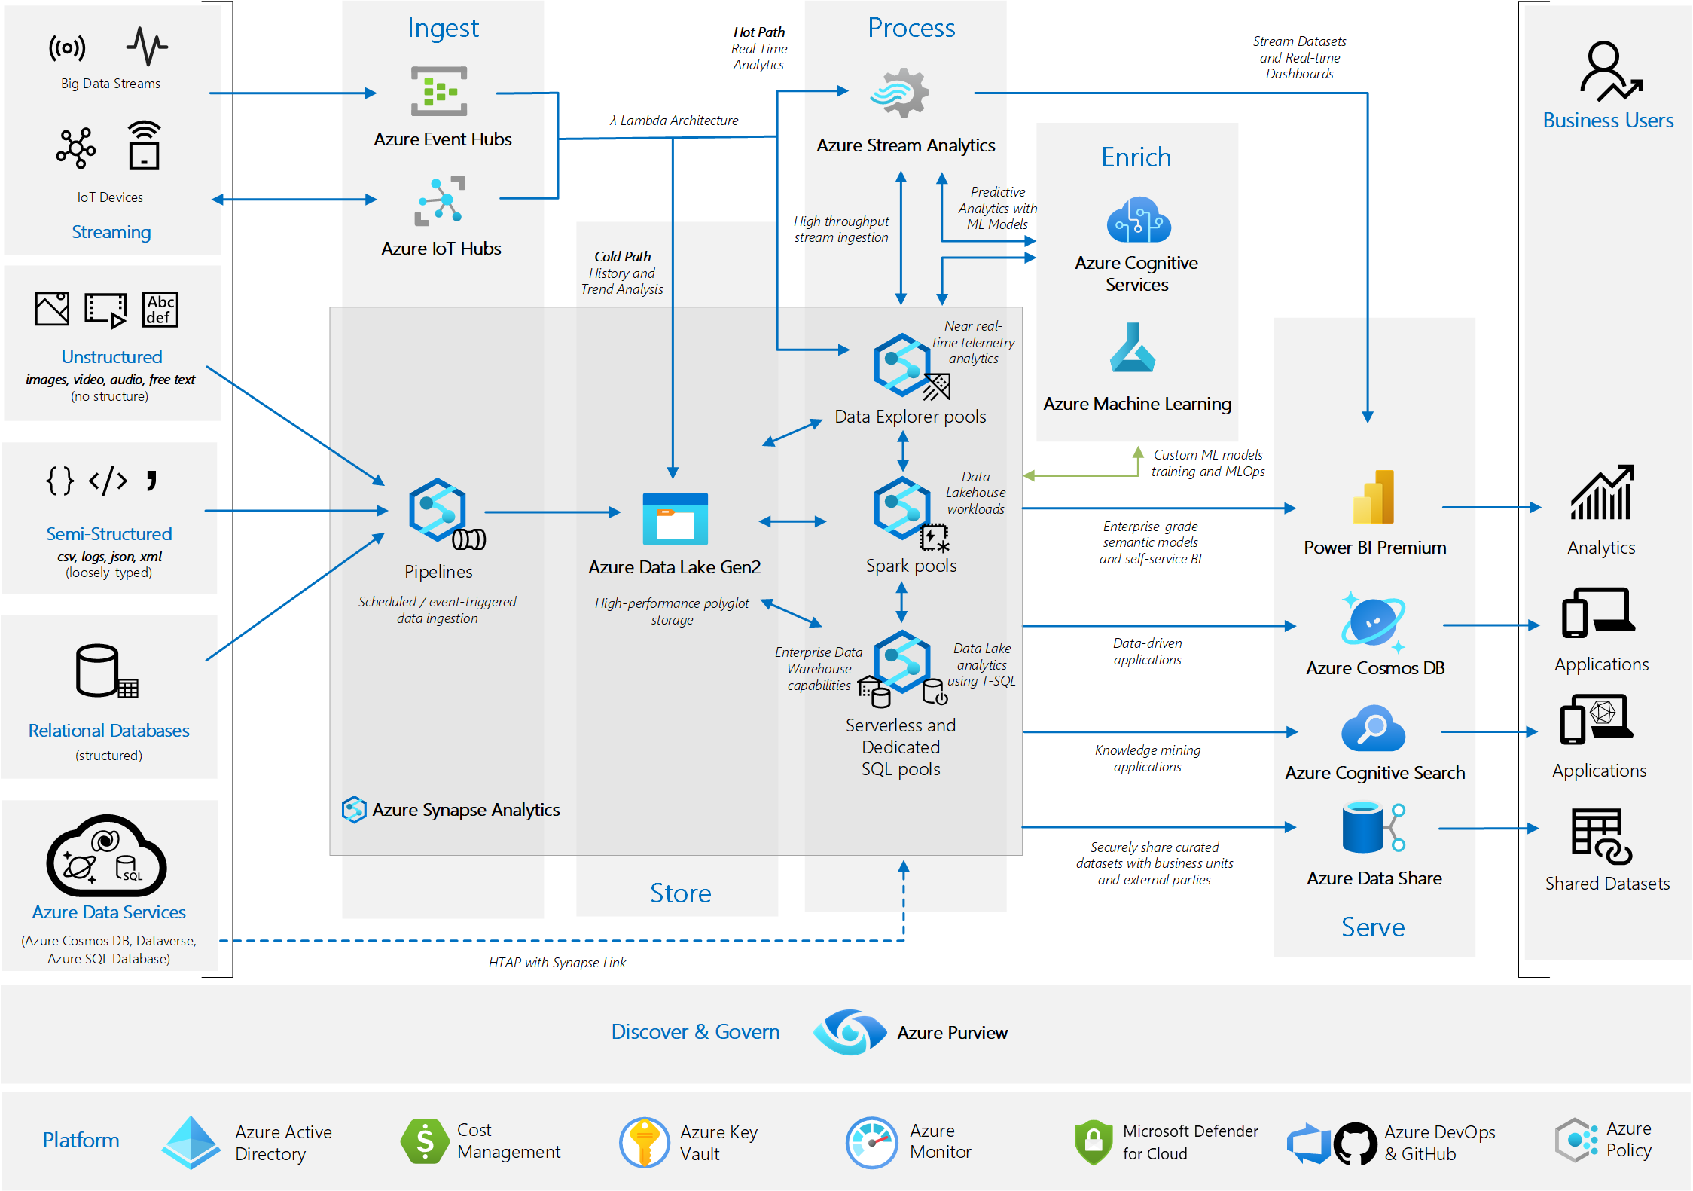

Slide 9
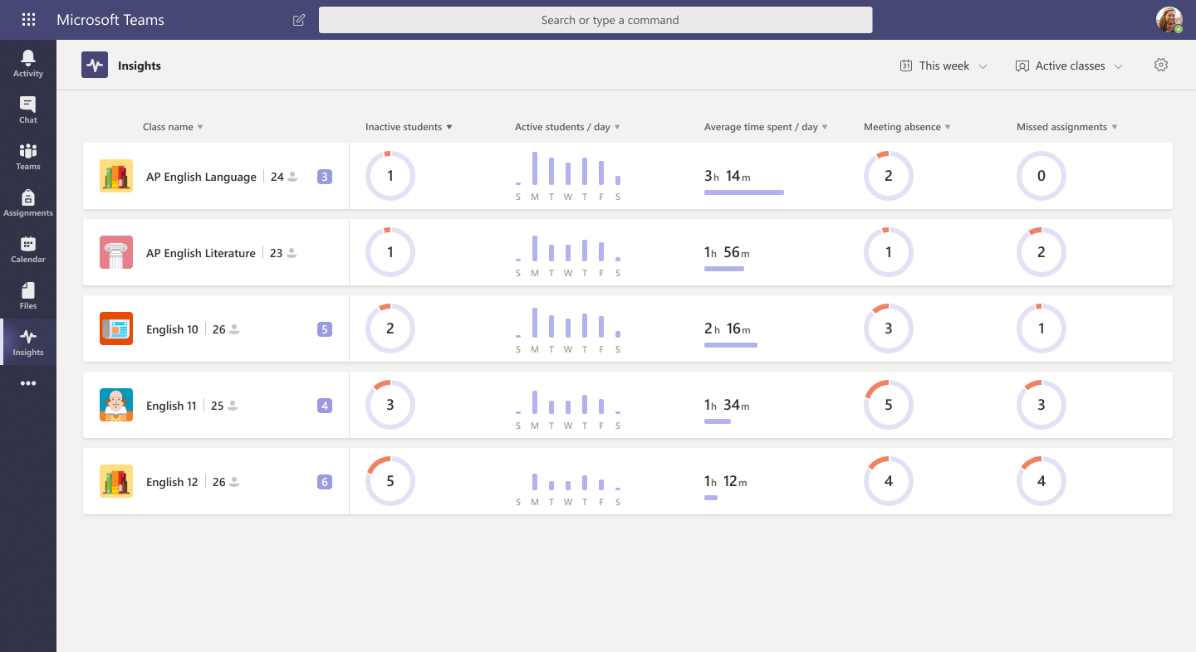
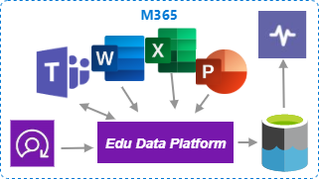

Education Analytics and Insights
Customer’s Azure Subscription
SIS

Slide 10
standards
reusable assets/
best practices
rapid iteration/
emergent design
modern tech
ecosystem / global community
standards

Slide 11




Data Engineers
Data Scientists
Analysts
Open Education Analytics
on-prem data
Administrators
cloud data
Azure Synapse Analytics
Power BI
Teachers,
Faculty
SaaS data
Students, Parents
1) Collect
2) Ingest
3) Analyze
4) Publish
5) Inform
Notes:
The modern data estate enables you to take all this disparate data and give your teams of data engineers, data scientists, and researchers the tools and access they need to do computing and analytics over this data, unlocking many types of education scenarios.
But there are a million technologies you could use to set up the modern data estate.
Even within Microsoft Azure you have a lot of choices.
Microsoft Education has developed Open Education Analytics, rooted in Azure Synapse, to provide a solution that simplifies and accelerates the learning analytics and AI journey, pulling together the best tools from across the landscape of modern analytics and AI services, to unlock the potential of key education scenarios.

Slide 12


Data Engineers
Data Scientists
Analysts
Open Education Analytics
on-prem data
data processing
reporting
Synapse Analytics
Administrators
cloud data
storage
Data Lake Storage
Power BI
Teachers,
Faculty
SaaS data
data governance
Purview
Students, Parents
authentication/authorization
Azure Active Directory
1) Collect
2) Ingest
3) Analyze
4) Publish
5) Inform
Notes:
The modern data estate enables you to take all this disparate data and give your teams of data engineers, data scientists, and researchers the tools and access they need to do computing and analytics over this data, unlocking many types of education scenarios.
But there are a million technologies you could use to set up the modern data estate.
Even within Microsoft Azure you have a lot of choices.
Microsoft Education has developed Open Education Analytics, rooted in Azure Synapse, to provide a solution that simplifies and accelerates the learning analytics and AI journey, pulling together the best tools from across the landscape of modern analytics and AI services, to unlock the potential of key education scenarios.

Slide 13
Data Engineers
Data Scientists
Analysts
modules, schemas, packages
framework
on-prem data
data processing
reporting
Synapse Analytics
Administrators
cloud data
storage
Data Lake Storage
Power BI
Teachers,
Faculty
SaaS data
data governance
Purview
Students, Parents
authentication/authorization
Azure Active Directory
1) Collect
2) Ingest
3) Analyze
4) Publish
5) Inform
Notes:
The modern data estate enables you to take all this disparate data and give your teams of data engineers, data scientists, and researchers the tools and access they need to do computing and analytics over this data, unlocking many types of education scenarios.
But there are a million technologies you could use to set up the modern data estate.
Even within Microsoft Azure you have a lot of choices.
Microsoft Education has developed Open Education Analytics, rooted in Azure Synapse, to provide a solution that simplifies and accelerates the learning analytics and AI journey, pulling together the best tools from across the landscape of modern analytics and AI services, to unlock the potential of key education scenarios.

Slide 14
Data lake structure
Stage 1
Stage 2
Stage 3
land
ingest
refine
enrich
publish
Bronze
Silver
Gold
Raw Data
Query Ready Data
Report /Model Ready Data

Slide 15
Processing Steps Defined
1) land
extract from source system
land in original format, in batches
no validation done at this point, no transformations
2) ingest
process inbound batch files (parse and read into a dataframe)
sanity check (validation only at the batch level to ensure it’s a reasonable dataset to be merged in)
add unique id at the entity level if needed (when merging data from multiple db’s, eg EdFi)
no data loss (no data is dropped on the floor)
merge into delta lake (rename columns to remove spaces to satisfy parquet requirements)
3) refine
include schema info (data types)
transformations (json flattening, generate hkey values)
pseudonymization
4) enrich
validation
transformations, aggregations
additional enrichment from other data sources
map to standard schemas
5) publish
publish to data products
transformations to build star schema
compute aggregations

Slide 16
Stage 1
Stage 2
Stage 3
Ingested
|-EdFi
|--v5.3
|---courses
|----_delta_log
|----SchoolYear=2017
|-----DistrictId=255901
|------>part-000.parquet
|---students
Transactional
|-EdFi
|--v5.3
|---DistrictId=255901
|----SchoolYear=2017
|-----courses
|------delta_batch_data
|-------upserts
|--------rundate=2022-09-13
|--------->data-d782.json
|-------deletes
|--------rundate=2022-09-13
|--------->data-ab34.json
1) land
2) ingest
Refined
|-EdFi
|--v5.3
|---Sensitive
|----courses_lookup
|-----_delta_log
|-----SchoolYear=2017
|------DistrictId=255901
|------->part-000.parquet
|---General
|----courses
|-----_delta_log
|-----SchoolYear=2017
3) refine
|-GraphAPI
|--v1.3
|---SchoolYear=2017
|-----userlogins
|------additive_batch_data
EdFiAMT
|-v1.2
|--General
|---students
|----_delta_log
EdFiByEdGraph
|-v2.3
Enriched
|-EdFiAnalytics
|--v0.1
|---Sensitive
|----students_lookup
|---General
|----students
4) enrich
5) publish
Raw Data
Enriched/Query ready Data
(enriched datasets)
Report /Model Ready Data (data products)

Slide 17
Stage 1
Stage 2
Stage 3
modules
Ingested
|-EdFi
|--v5.3
|---courses
|----_delta_log
|----SchoolYear=2017
|-----DistrictId=255901
|------>part-000.parquet
|---students
Transactional
|-EdFi
|--v5.3
|---DistrictId=255901
|----SchoolYear=2017
|-----courses
|------delta_batch_data
|-------upserts
|--------rundate=2022-09-13
|--------->data-d782.json
|-------deletes
|--------rundate=2022-09-13
|--------->data-ab34.json
1) land
2) ingest
Refined
|-EdFi
|--v5.3
|---Sensitive
|----courses_lookup
|-----_delta_log
|-----SchoolYear=2017
|------DistrictId=255901
|------->part-000.parquet
|---General
|----courses
|-----_delta_log
|-----SchoolYear=2017
3) refine
|-GraphAPI
|--v1.3
|---SchoolYear=2017
|-----userlogins
|------additive_batch_data
Enriched
|-EdFiAnalytics
|--v0.1
|---Sensitive
|----students_lookup
|---General
|----students
EdFiAMT
|-v1.2
|--General
|---students
|----_delta_log
EdFiByEdGraph
|-v2.3
4) enrich
5) publish
schemas
Raw Data
Enriched/Query ready Data
(enriched datasets)
Report /Model Ready Data (data products)

